Slide 1
A project report on DOS ATTACK submitted by
KHUSHBU
In partial fulfillment of the requirement for the Diploma of
Centre for Development and Advanced Computing of noida
In
Cyber Security

Slide 2
Introduction
A denial-of-service (DoS) is an attack meant to shut down a machine or
network,making it inaccessible to its intented users.
DoS attack accoplish this by flooding the target with traffic,or sending it information that triggers a crash.
The intruder basically targets the client on his weak or you may say it as an advantage of the internet,the network bandwidth & its connectivity DoS attack can be branched into categories based on the perspective of attacks being performed.
1.Network level
2.Application level
3.Operating level & finally data level.
The intruder or may say the attacker targets these open points and flood 1000’s or millions of packets so that the machine gets either crashed or dies servicing all those request, if the machine choose to service the packets the machine will waste all the time by just servicing them which may include connection or data request packets and will not be able to service the clients who are genuinely wanting service from the machine.
Victims of DoS attack often target web servers of high-profile oraganizations such as banking,commerce and media companies, or government and trade organization.

Slide 3
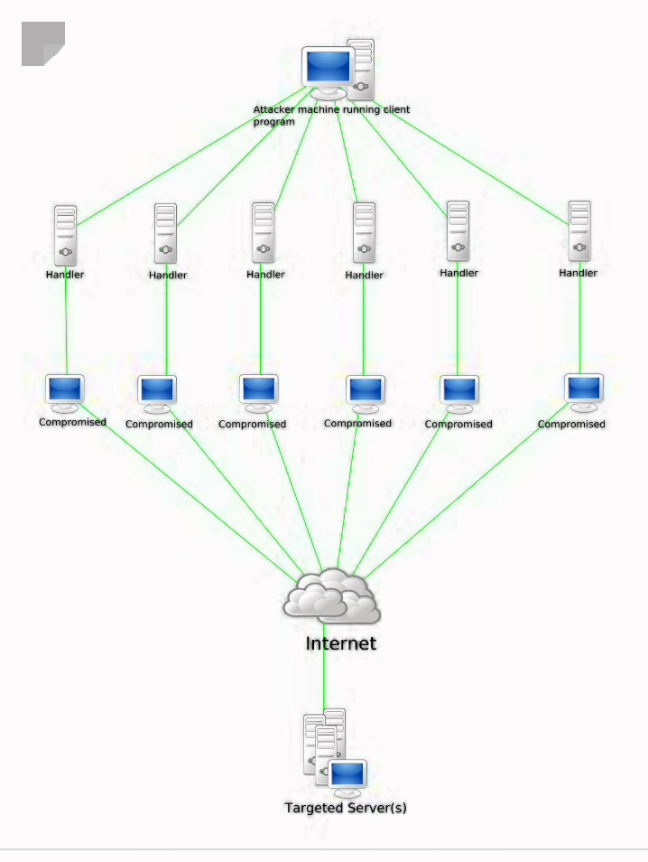

Slide 4
LITERATURE SURVEY
The major threat in DoS attack is the mass amount of packet,rather than the contents in the packets flooding DoS attacks create a problem in today’s network architectures.
Overthrowing the use of network protocol :- Transmission control protocol(TCP),User datagram protocol (UDP) enabling the attacker to thwart the services provided by the victim, by generating huge amount of traffic on the victim & its rather, enabling them to crash instantly.

Slide 5
INCIDENTS
September 1996:- The very first DoS attack occurred against panix (New york ISP) using SYN.
IN 1997:- The earliest DoS attack was happened by khan C. Smith during a DEFCON event, disrupting internet access to the Las Vegas strip for an hour.
January 2001:- First major attack involving DNS servers against Register.com.
February 2007:- Over 10,000 online game servers attacked by group RVS.
December 2010:- A group called “ Anonymous “ successfully attacked Mastercard.com, PayPal & Visa.com but failed against Amazon.com.
IN above we study about some kind of DoS attack incident was happened in last few years.

Slide 6
APPROACH
In this we have performed a DoS attack on vulnerable website using LOIC (Low Orbit Ion Cannon) is a widely available, open-source application developed by praetox Technologies used for network stress testing, as well as DoS attack or DDoS attack.
LOIC to flood target system with junk TCP,UDP & HTTP GET requests.
A UDP flood attack is a vulnerable DoS attack using the user datagram protocol,a sessionless, connectionless computer networking protocol.
UDP flood exploits the target systems diagnostic echo services to create an infinite loop between two or more UDP service.
DoS attack prevent using Cloudflare this is one of the biggest networks operating on the internet. People use cloudflare services for the purpose of increasing the security and performance of their website & services and also use firewalls because they can block the offending IP addresses or the ports they are attacking.

Slide 7
IMPLEMENTATION & RESULT
How to perform DoS attack on a website to perform the attack we are going to use LOIC application .
Open kali Linux first we need install Monodevelop which is use to run and compile .
We need to create new directory then we need to change loic permission.
We lunch loic we need we need to install monodevelop complier is used to compile for net. Application
Then we ready to lunch LOIC graphical user interface & configured the dos attack, LOIC use to simple user friendly attack.
We need to identify target website URL then go to loic and click to the char to the subsite/message.
We need to change attack method UDP then enter value of threats 50 and other setting left default.
Now we are going to website that is programming well or not enter URL in browser then back LOIC and click to button IMMA CHARGIN MAHLAZER.
The value of request should be increasing that means DoS attack working well then lets back into the website enter URL we saw website no longer responding this is because we are flooding the web server excessive amount of garbage request.
When we are stop to the attack simply move to loic & click button stop flooding
This is how DoS ATTACK perform .

Slide 8
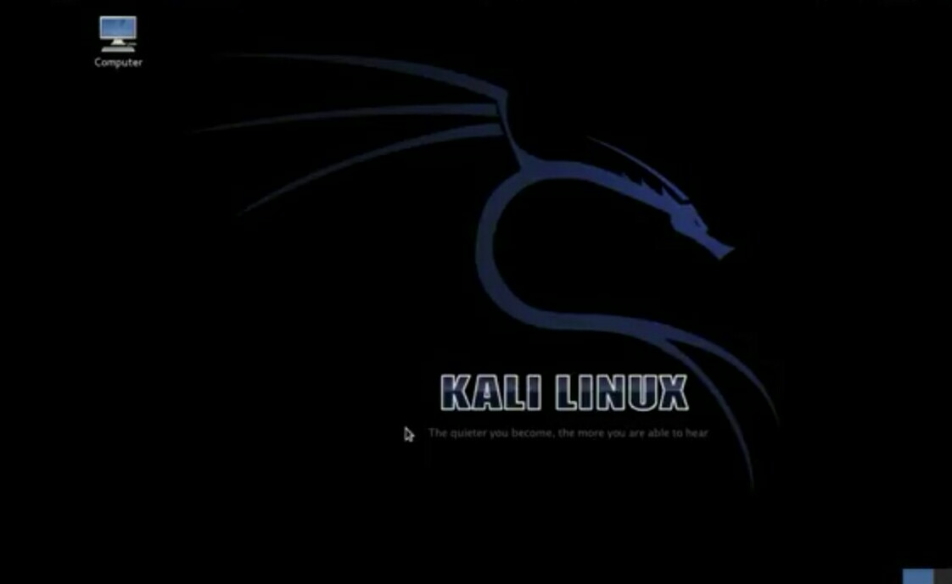
Install kali Linux it is how to look like ..

Slide 9
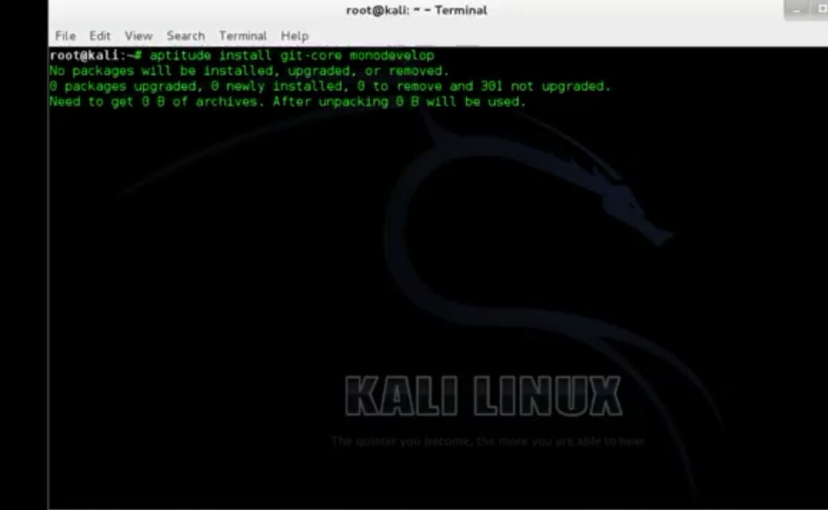
First we install monodevelop which is use to run and compile key word is aptitude .install git-core monodevelop

Slide 10
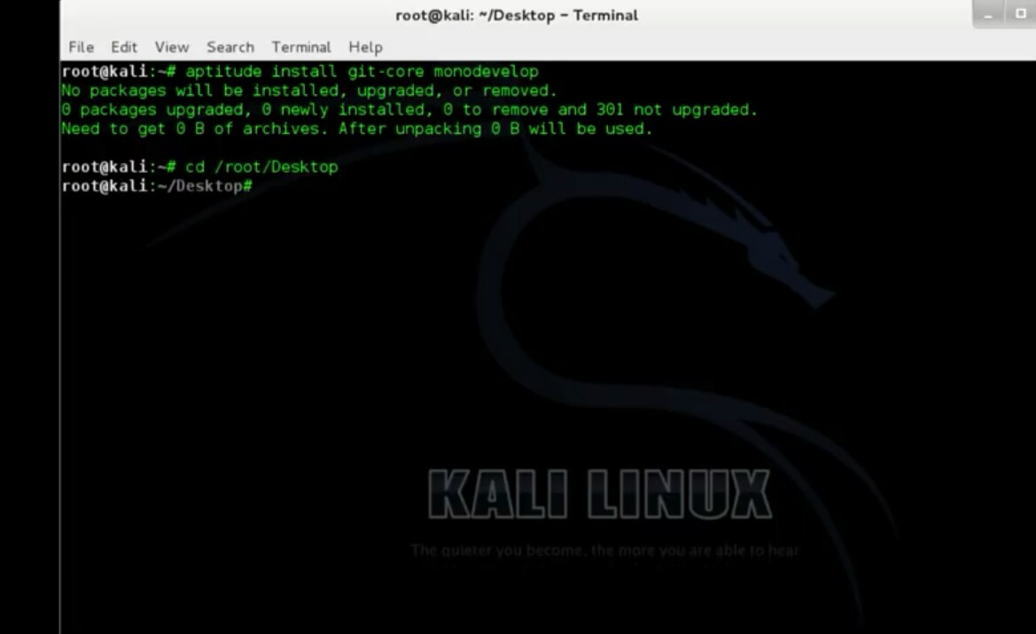
Type; cd/root/desktop

Slide 11
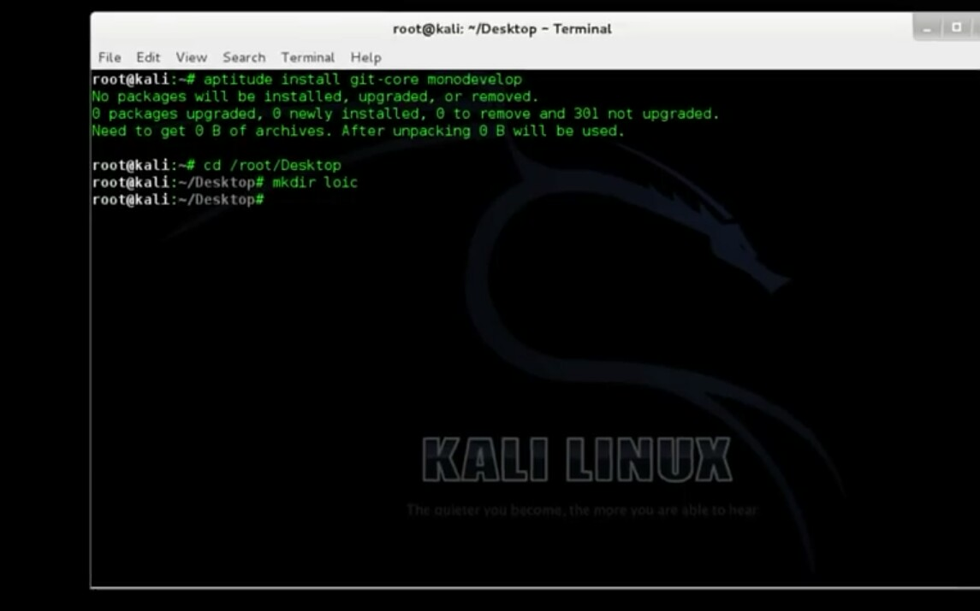
We need to create a new directory ; mkdir loic

Slide 12
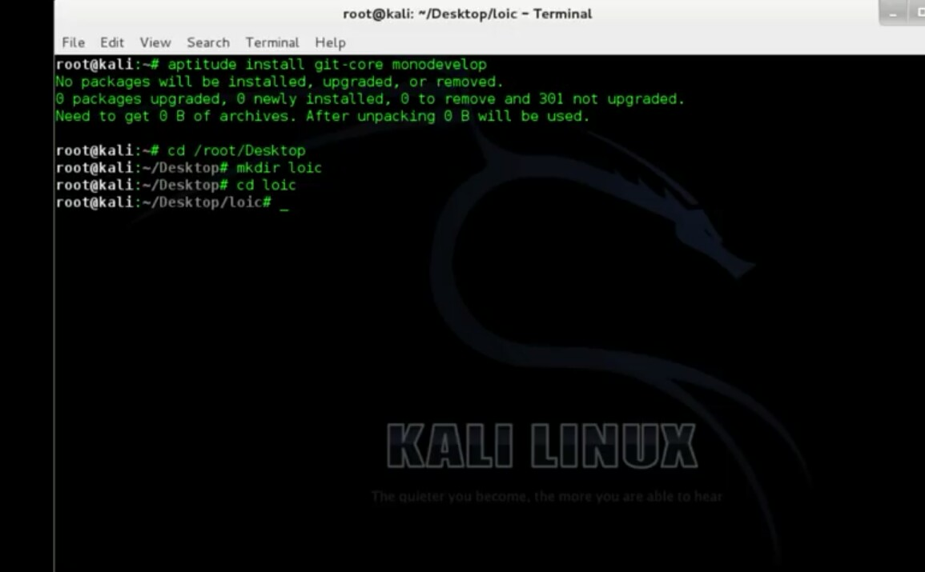
New folder ; cd loic

Slide 13
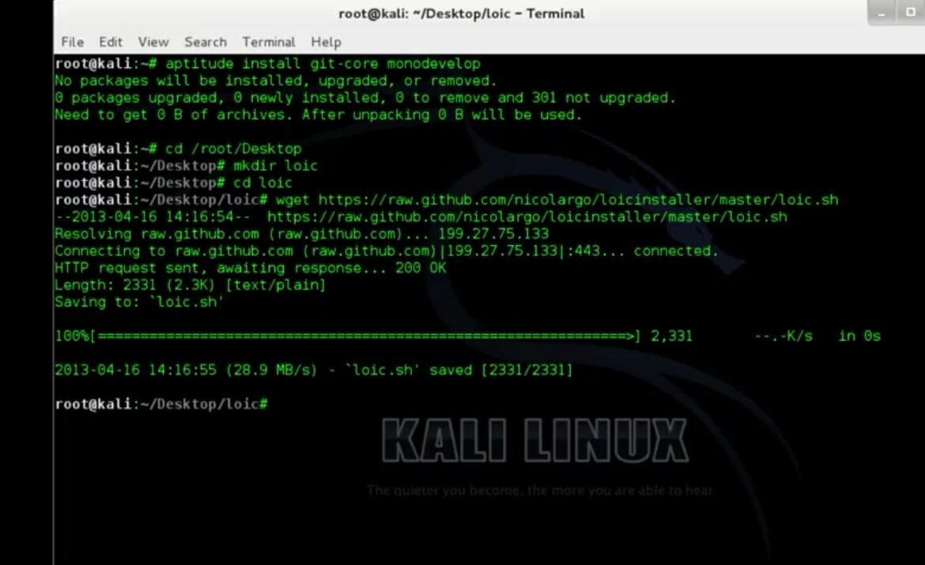
For retrieve new file ; wget https://raw.github.com/nicolargo/loicinstaller/master/loic.sh

Slide 14
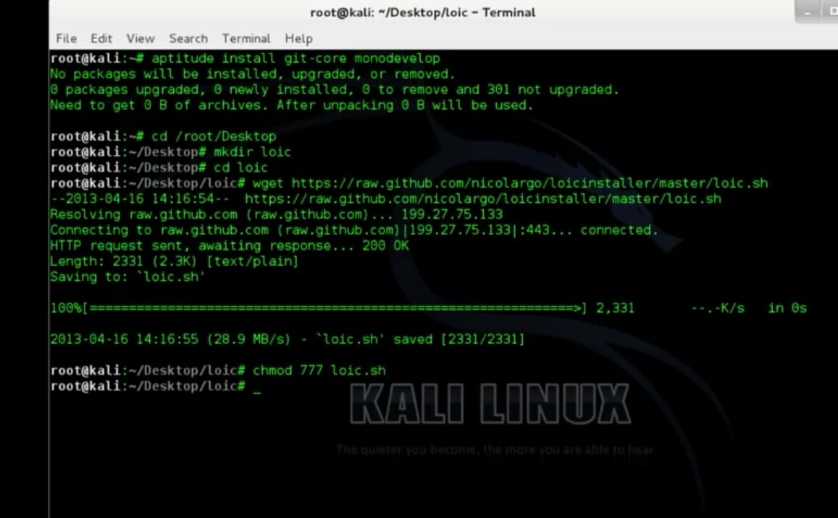
We need to change loic permission so install; chmod 77loic.sh

Slide 15
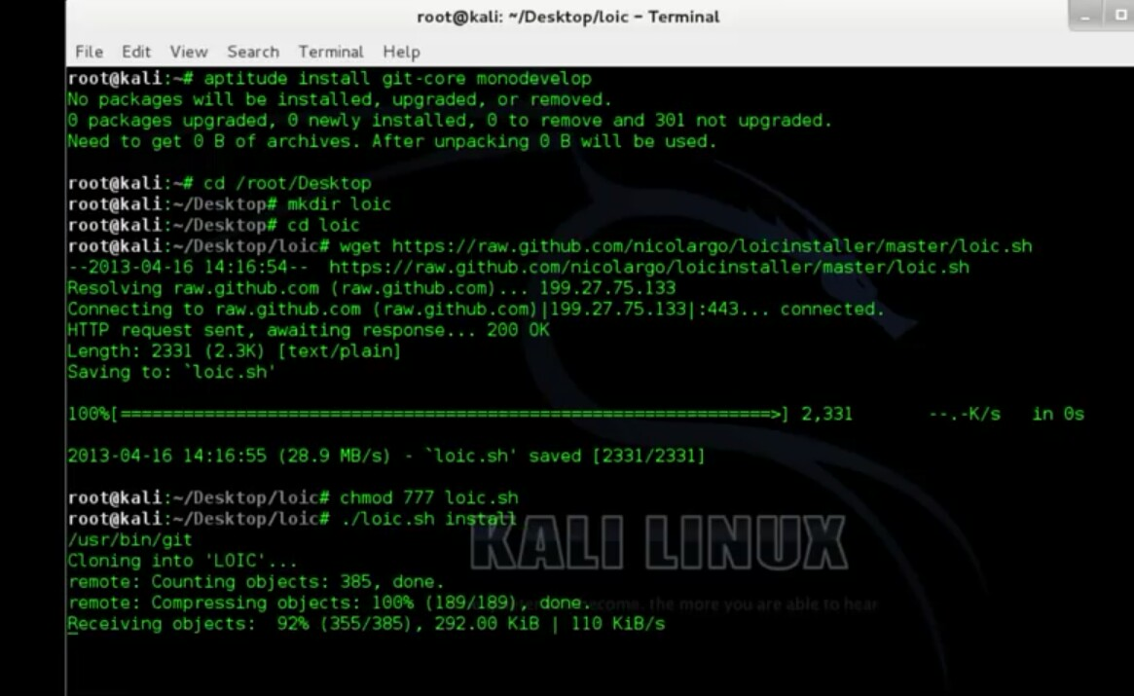
We need to install loic application; ./loic.sh install

Slide 16
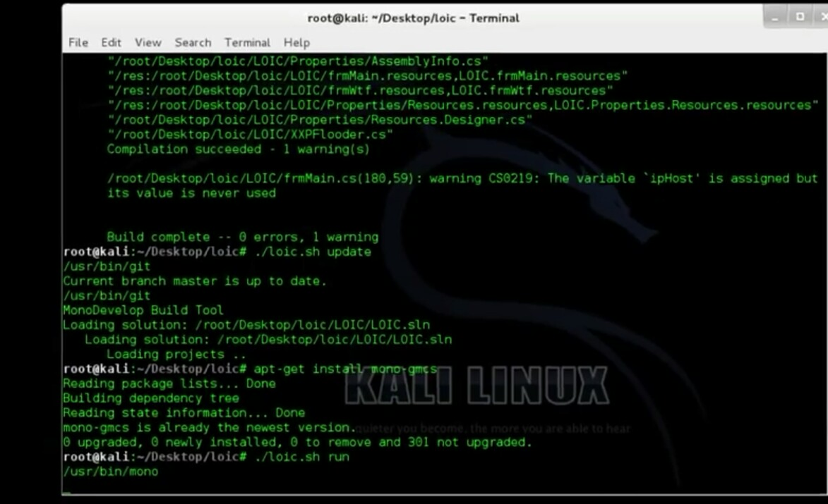
Update loic;./loic.sh update install monodevelop compilier;apt.get install mono-gmcs lunch loic;./loic.sh run

Slide 17
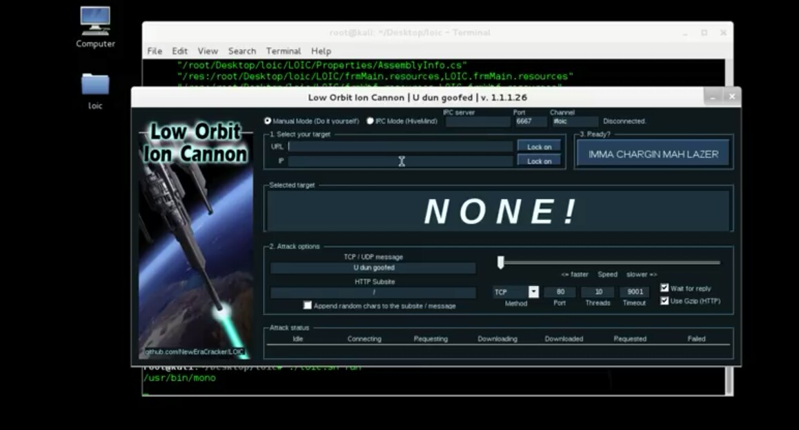
Loic interface look like

Slide 18

Target website found by goggle docx; http://ww.substudiophotography.com

Slide 19
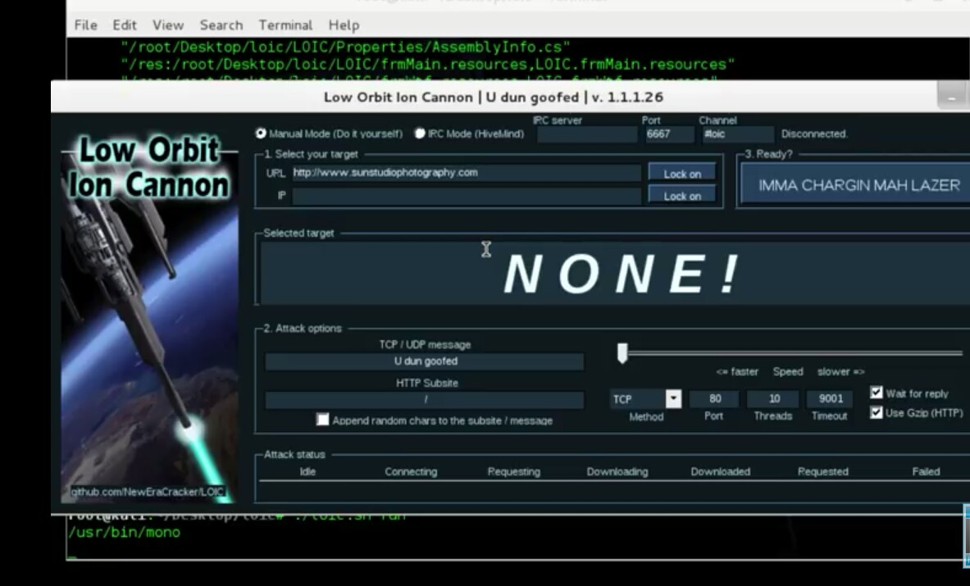
Type URL on loic interface than lock on

Slide 20
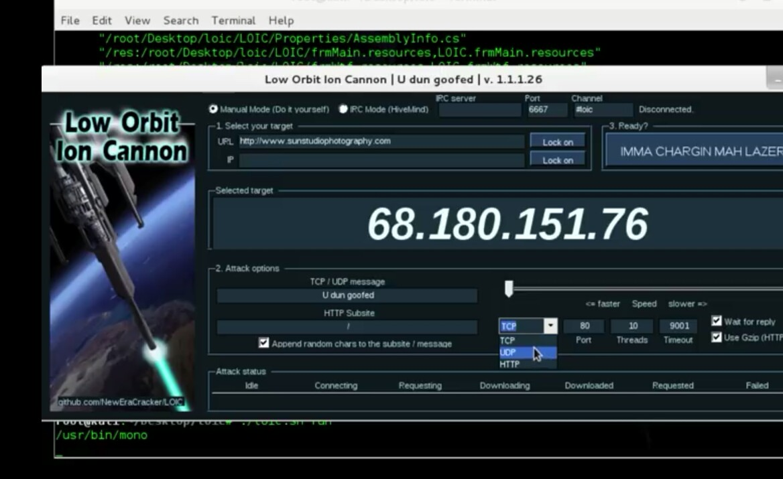
Click on random char to the subsite /message and also change method in UDP

Slide 21
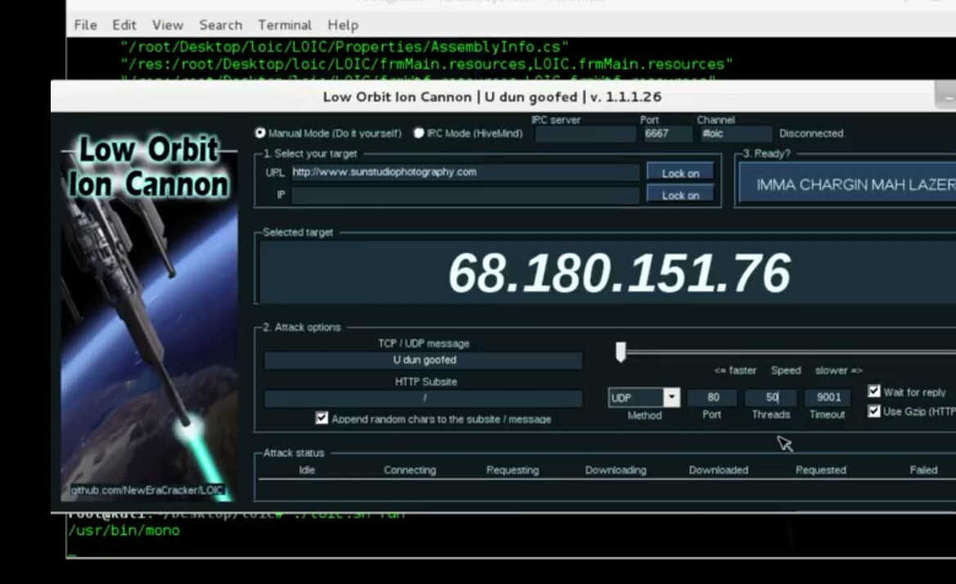
Now enter value of threat is 50

Slide 22
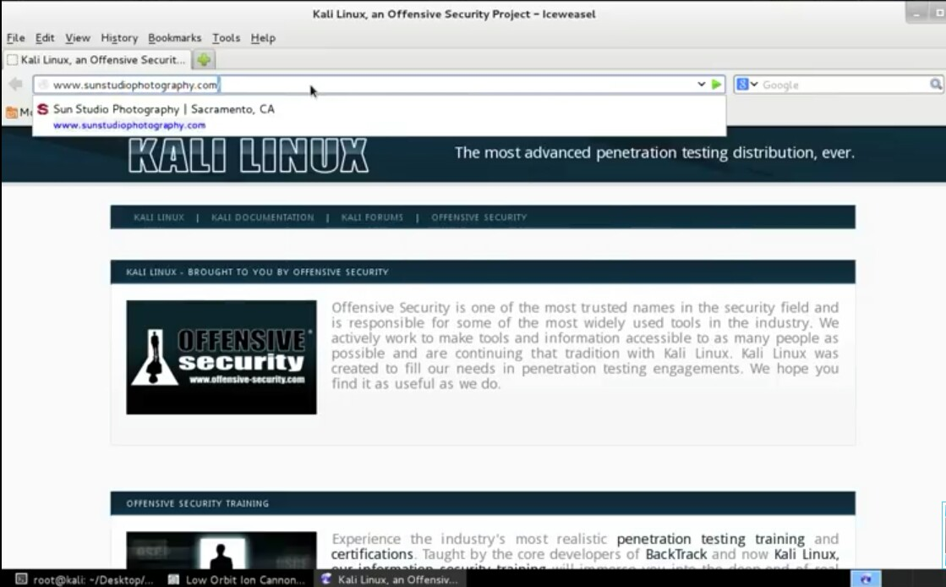
Now we are going to website is performing well or not

Slide 23
Here Website performing well

Slide 24
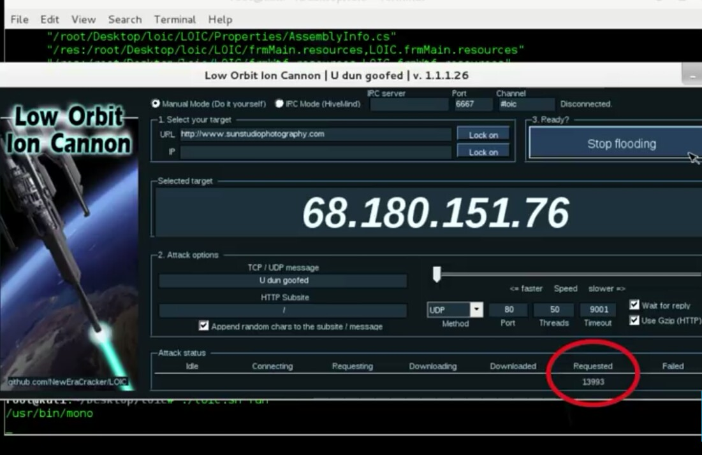
Now back to loic interface and press the button IMMA CHARGIN MAH LAZER then you see value of garbage request should be increase.. that means dos attack working properly

Slide 25
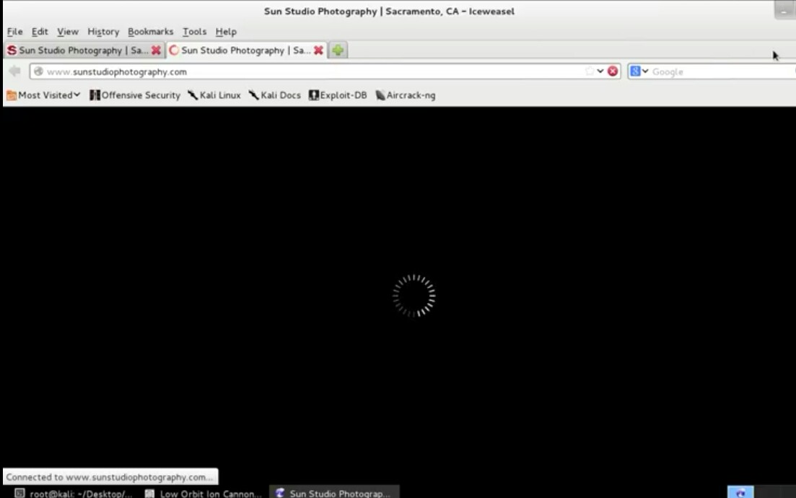
now we saw the website not finding properly it means no longer response this is because we are flooding

Slide 26
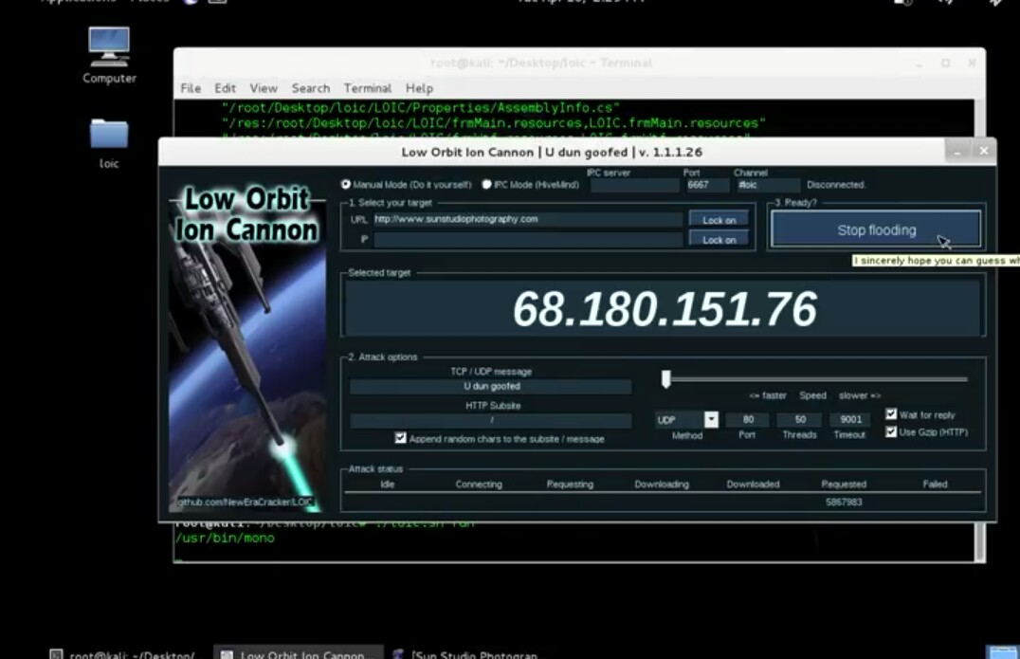
now for preventing attack press the button stop flooding

Slide 27
CONCLUSION
In this irrefutably said that DoS attack and DDoS are series problem in the internet today and it exchanges the behavior of internet which provided a wide variety of use to the client.
In this we explored to achieve a view of the DoS attacks & performed in a vulnerable website and we have to protect these Denial-of-service attacks.

